Slide 1
CS 498
Virtual Reality
4/15/2019

Slide 2

VR Design Reminders: General Concerns
Cognitive load & Kinematic Load
Cognitive load refers to the amount of mental processing needed to use your product.
Kinematic Load refers to the amount of physical activity needed to use your product.
Dealing with Cognitive Load
Give users time to adapt to the new environment
Give users control over their navigation (Driver vs Pass)
Give the user clear directions/goals
Avoid Depth Confusion
Use Rest Frames if possible
Dealing with Kinematic Load
Limit arm, elbow and hand movement
Target the simplest method and support high end

Slide 3
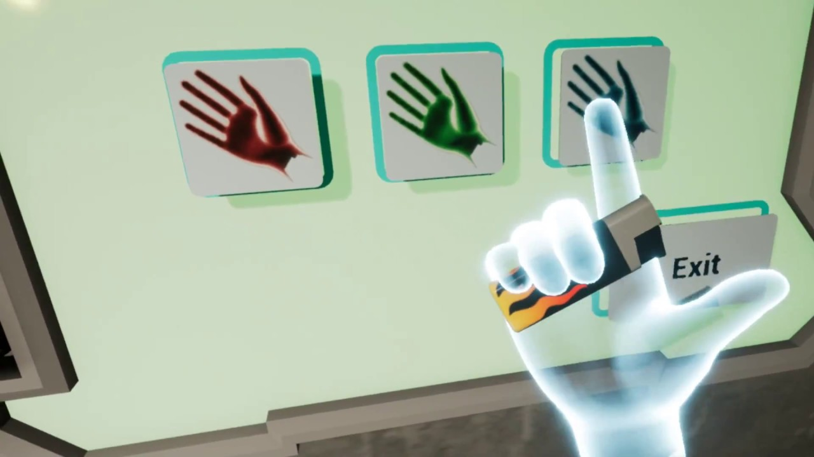
VR Design: Summary of General Concerns Yasser Malaika (Valve), Patrick O'Luanaigh (nDreams) Mike Agler (Google) , Design Best Practices (Oculus)
Presence but not full reality
Keep the user in your world but simplify the repetitive and mundane
Hand representation is key, players notice when things are wrong with game hands
Non-realistic hands
Don’t create an expectations where hands have to do more than is comfortable in VR
Example: Oculus’ Lone Echo’s https://www.youtube.com/watch?time_continue=42&v=CyP3LZNa_IA

Slide 4
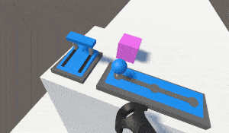
VR Design Summary of General Concerns: Affordances Yasser Malaika (Valve), Patrick O'Luanaigh (nDreams) Mike Agler (Google) , Design Best Practices (Oculus)
Don’t create objects that don’t behave as expected (handles on pots, etc.)
Make sure that objects that look like you can interact with them CAN be interacted with
Drawers with handles should open, etc.
Real isn’t as important as ease of use as simple functionality
Job Simulator: Gourmet Chef https://www.youtube.com/watch?v=qZX_WVhL3eg
KFC Job Training: (2:00) https://www.youtube.com/watch?v=LritONRSiXc
Watch out for simulation fatigue
Don’t make a person use big gestures to do common place things
Make any gesture a satisfying and meaningful experience

Slide 5
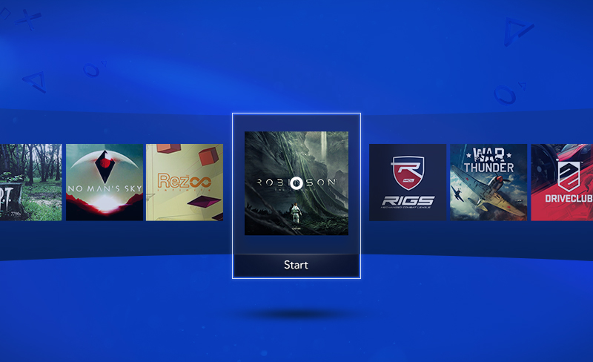
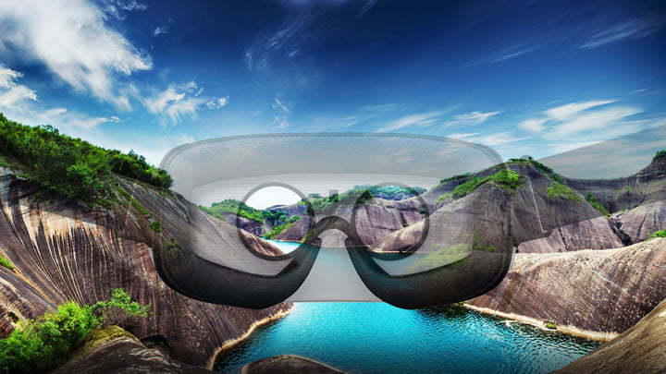
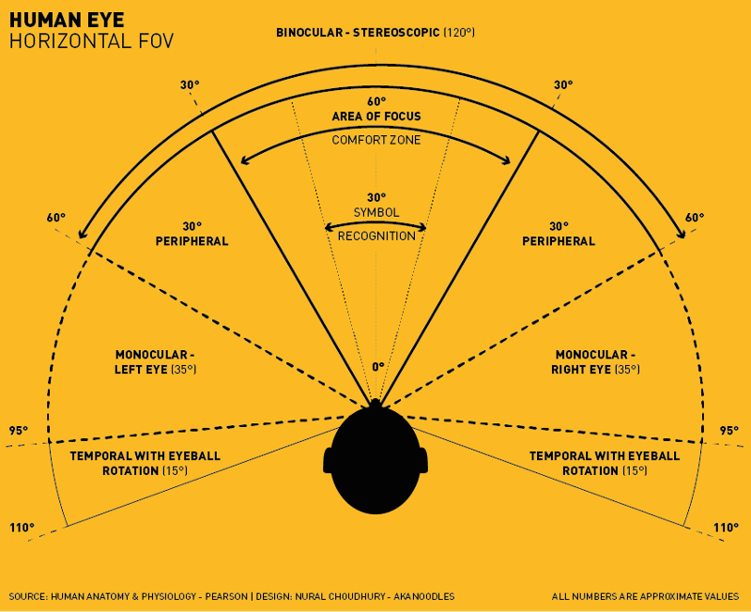
VR Design Specifics: Physical factors that impact Target Zones
Interesting physical limitations (Medich)
Standing: Easier to look left/right
Sitting: Easier to look up/down
Think about this in terms of platform
Head turning can be uncomfortable (Alger)
Recommended view frustum ±35°
Note that an Imax screen is 70° from center seat
Anything over 77° isn’t comfortable for viewing
The center 55° get the primary focus
This is important for specific kinds of applications
Showing a video
Using horizontal panels for user interface
© Nixson Sysanga

Slide 6

VR Design Specifics: Joe Ludwig (Valve)
Best Content Depth in VR
Because of the convergence rotational angle of the eye
Anything within .5 meters of the head crosses the eyes
Don’t put anything to read or focus on inside 1 meters
Content in VR shows best between 1 and 10 meters, 10 to 20 meters provides good VR
Anything beyond 20 meters and the eyes see the same image (flattening it out)

Slide 7
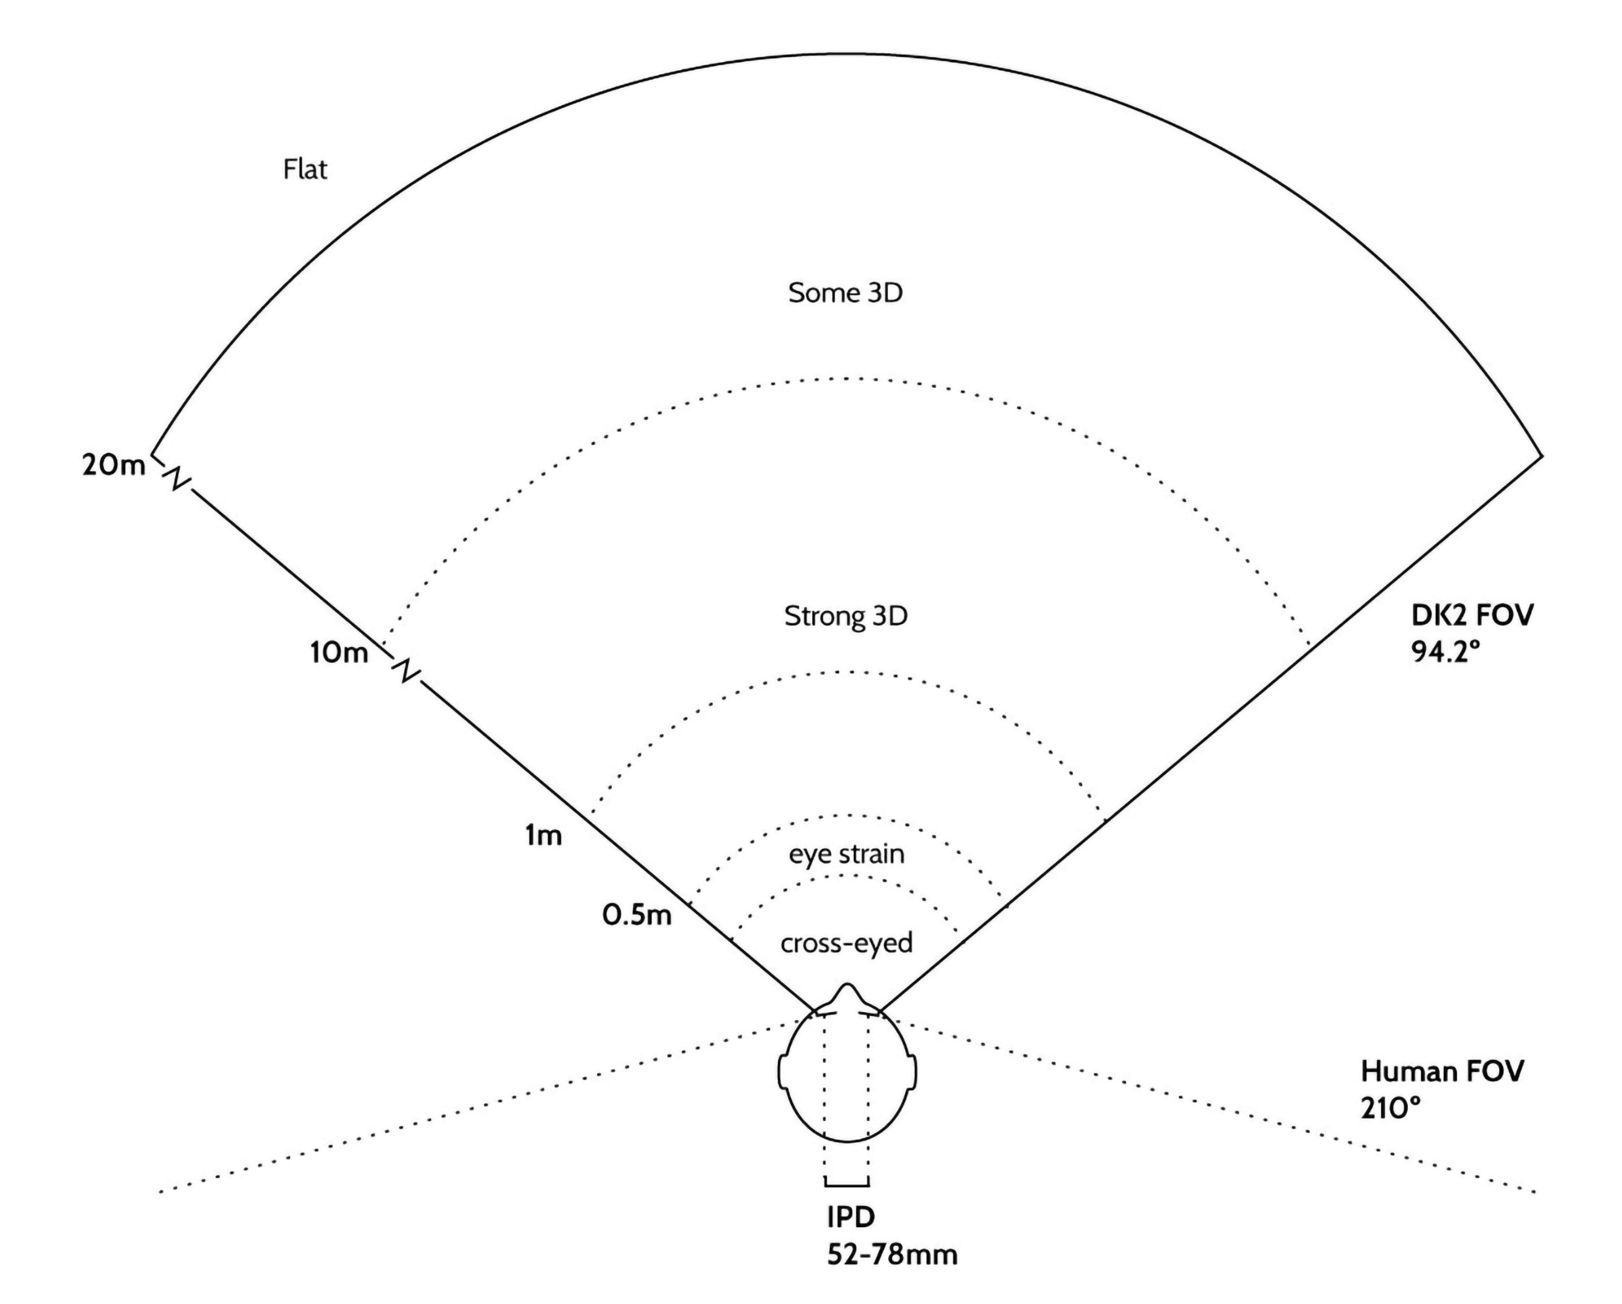
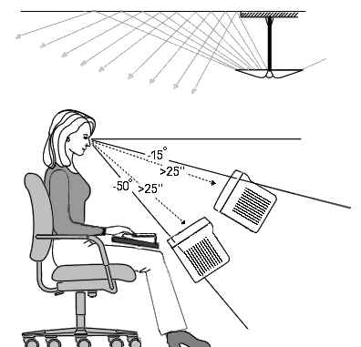
VR Design Specifics – Ergonomics Alger

Slide 8
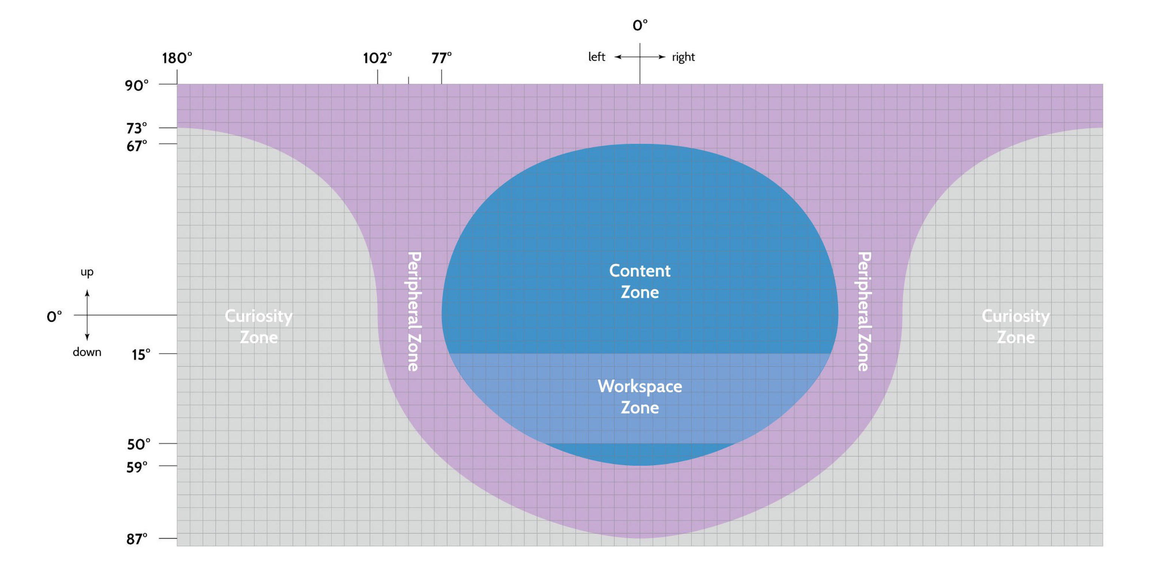
VR Design Ergonomics: User Information Zones (Out of the Eyes) Alger

Slide 9


Slide 10
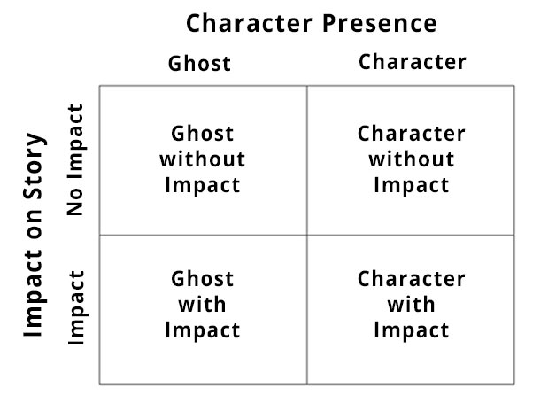
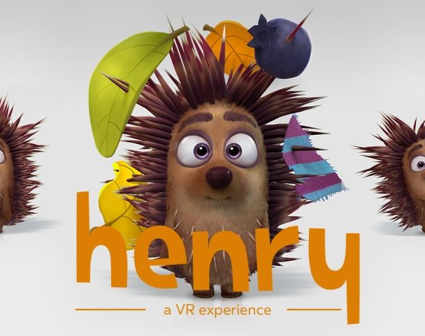
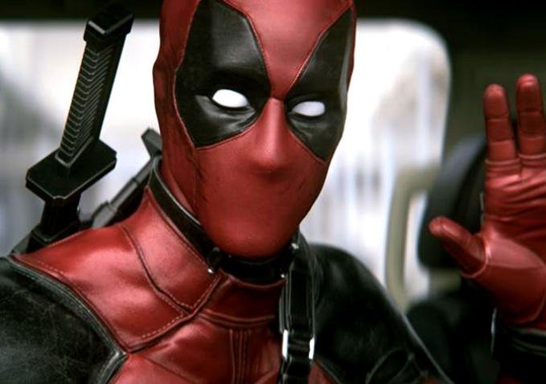
VR Design: General Concerns – Presence & Narrative
Mainstream media (movies, TV, books, most video games) have the “Fourth Wall”
Makes the user the observer
VR places the user in the experience
If 1st Person and the narrative doesn’t address the user as if present, it can be disturbing
You can make the user the observer but there is a loss of presence in that
VR movie makers have an issue with certain kinds of films
Henry (a short about a lonely hedgehog)
https://www.youtube.com/watch?v=IUY2yI5F16U
1:50 & 7:00
© D. Dolan

Slide 11
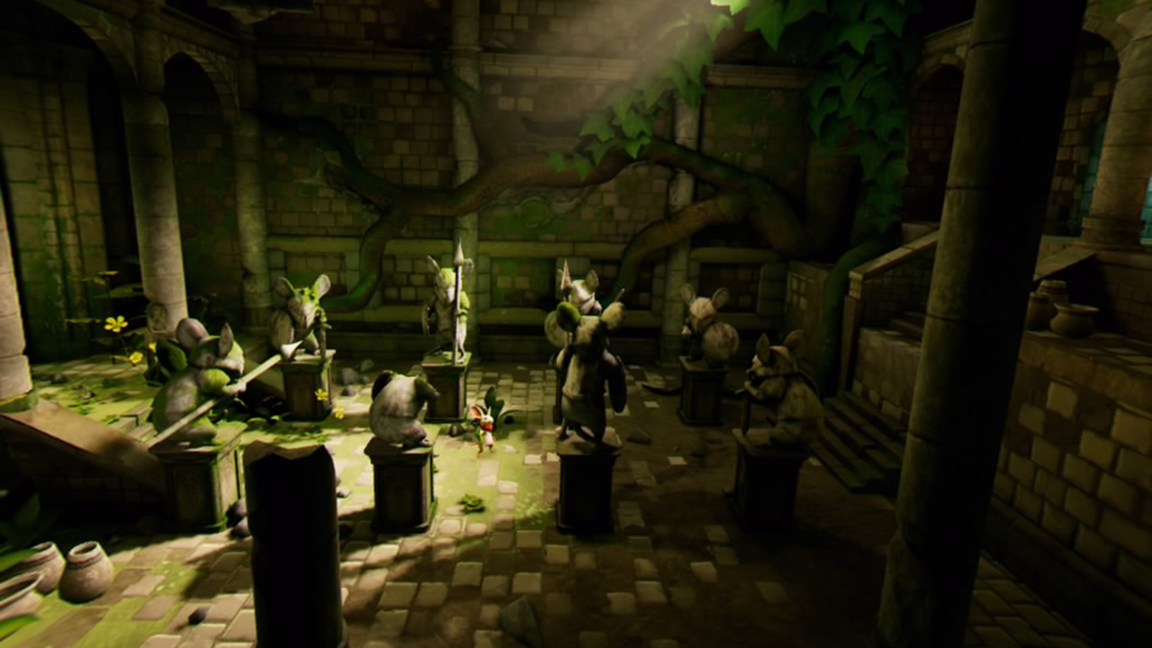
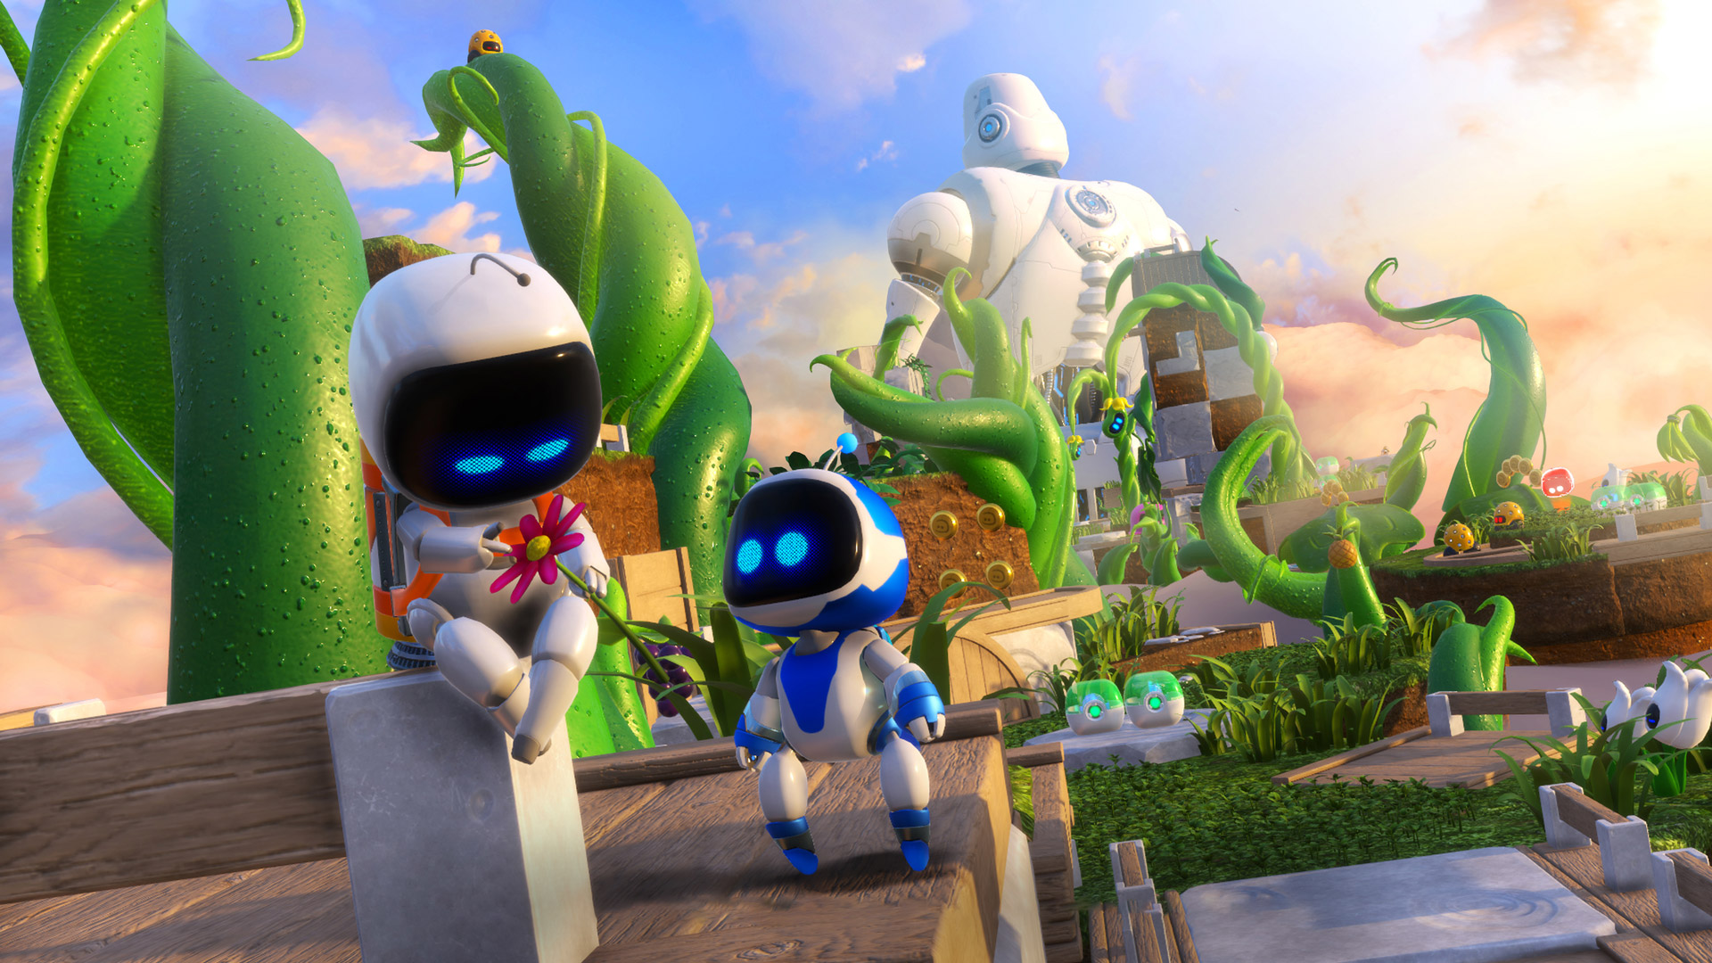
VR Design: General Concerns – Presence & Narrative
VR Games use 3rd person (Ghost with Impact) often
Moss and Astro Bot are very successful 3rd person games

Slide 12
VR Design: User Intent
Key aspect of User Experience
There are experiences you will want the user to have but what comes first?
What does the user want to do vs what do you want him to do?
How do you get the two elements to match?
Choice!
Don’t have one hierarchy of choices, give the user the freedom to choose their own path
Make sure the know what the choices are (get their attention)
Then Simplicity (it’s the old adage of KISS, Keep It Stupid Simple) – yeah I know it ain’t right
Take their intent and make it happen quickly and simply, don’t make the user work

Slide 13
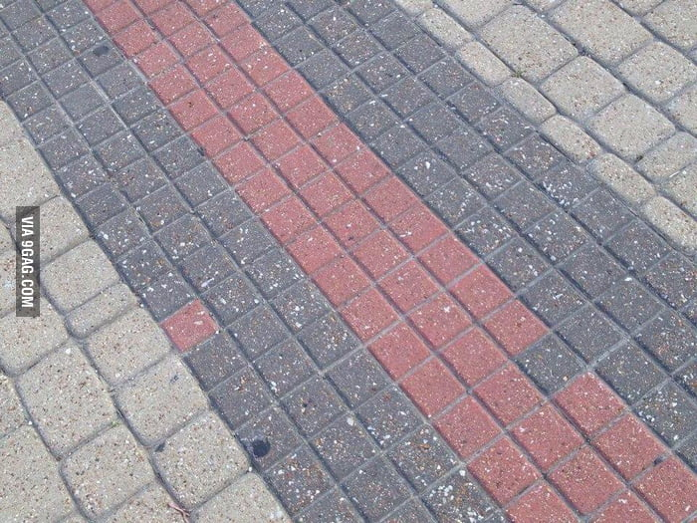
User Intent: Getting their Attention, so they can choose
Think about things that draw your attention in the real world
Pause, consider your user
Sound
Funnels, borders, elements that constrict flow
Things that standout against the background
Something out of place
Movement
https://accessibility.colostate.edu

Slide 14
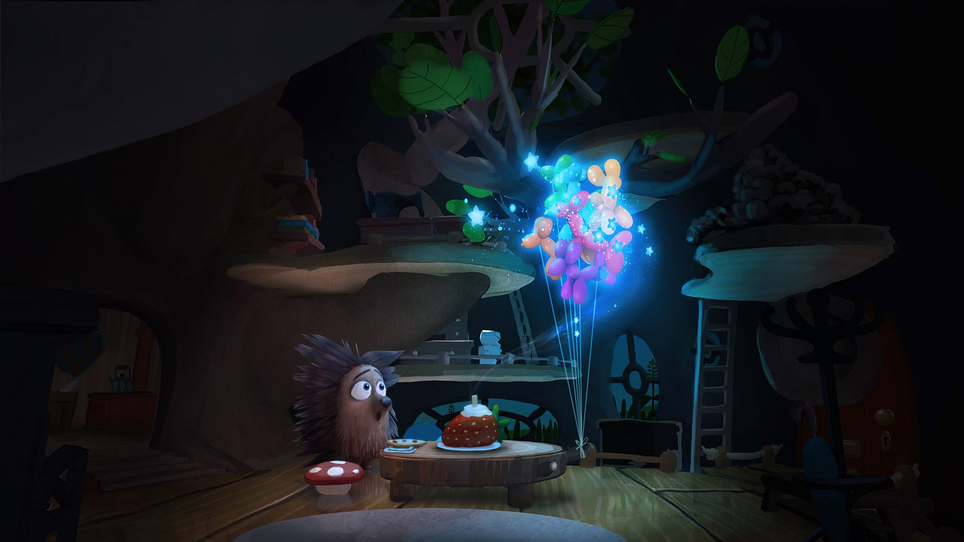
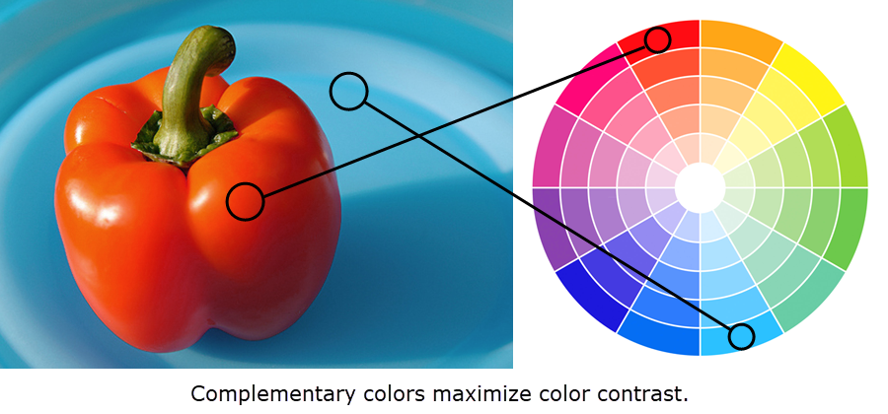
User Intent: Getting their Attention
Contrast is very powerful
Using Color is key
Lighting changes
Oculus Story Studio
https://accessibility.colostate.edu

Slide 15
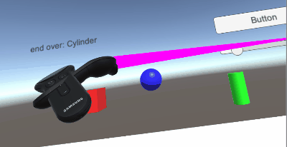
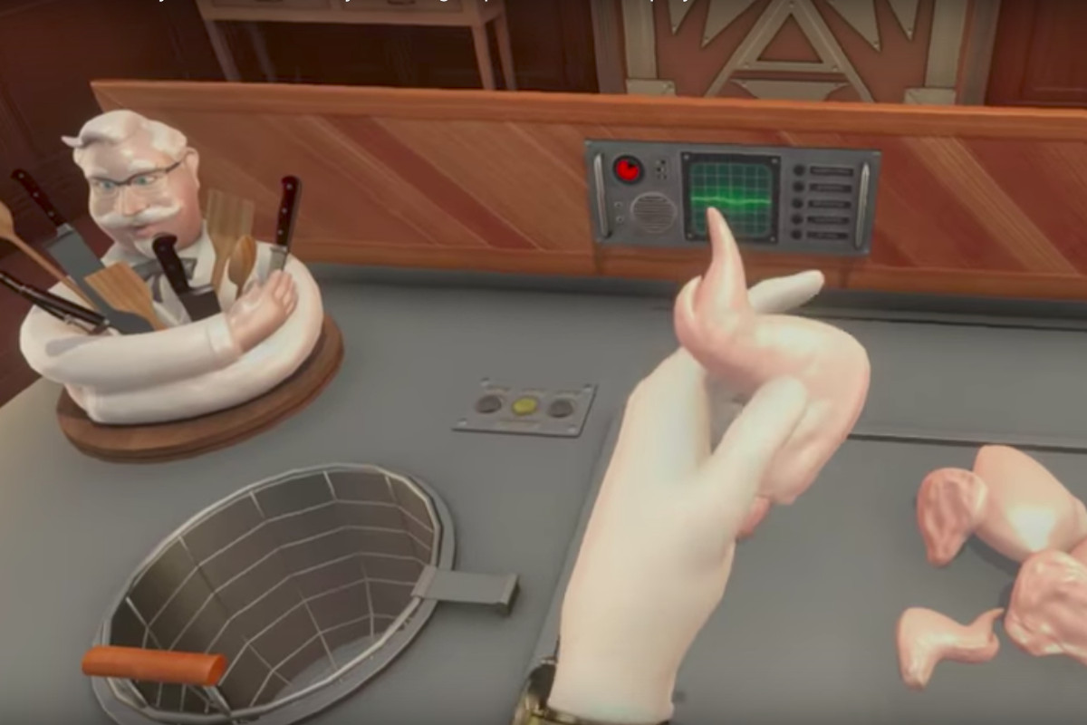
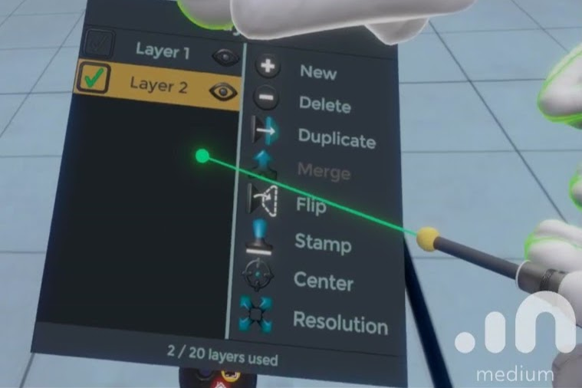
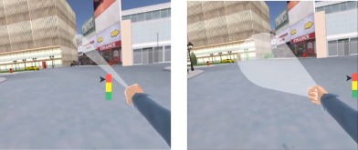
Object Interactions: Selection methodologies
Touching
Within reach (Local zone)
Hands are naturally mapped
You can also use a local pointer
Occlusion
Pretty much your standard 2D menu
Ray Cast (Mid/long range pointing)
Accurate method to choose
Variants include
Cone casting
Snap to (for teleportation)
Oculus developer forums
KFC
© 2017 Elsevier Ltd. All rights reserved.

Slide 16
Object Interactions: Selection methodologies
Arm Extentsion Selection
Go Go Technique
Non-linear mapping between physical and virtual hand position
Local and distant regions (linear < D, non-linear > D)
KFC
Poupyrev, I., Billinghurst, M., Weghorst, S., & Ichikawa, T. (1996). The Go-Go Interaction
Technique: Non-linear Mapping for Direct Manipulation in VR. Proceedings of the
ACM Symposium on User Interface Software and Technology, 79-80.
© 2017 Elsevier Ltd. All rights reserved.

Slide 17
Object Interaction: Considerations Leapmotion.com: design best practices
Interactive elements should be scaled to the expected interaction (e.g. full hand or finger/pointer size).
One finger/pointer targets should be no smaller than 20 mm in real-world size.
This ensures the user can accurately hit the target without accidentally triggering targets next to it.
Keep in mind that human hands naturally move in arcs, rather than straight lines.
Limit the number of gestures that users are required to learn.
All interactions should have a distinct initiation and completion state.
Ensure that users can interact with objects occluded by their hands.

Slide 18
Object Interactions: Selection Feedback
Feedback methods for selection available
Graphical Change
Voice
Color Change
Feedback method for selection made
Audio
Voice
Color Change
Graphical Change
Oculus developer forums

Slide 19
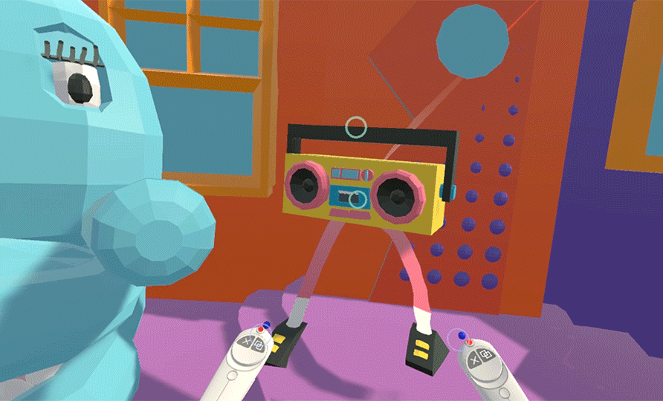
Object Interactions: Manipulation
Attachment, position, rotation, etc.
Examples: https://www.forrestthewoods.com/blog/the_vr_interface_of_dino_frontier/
Vrscout.com

Slide 20
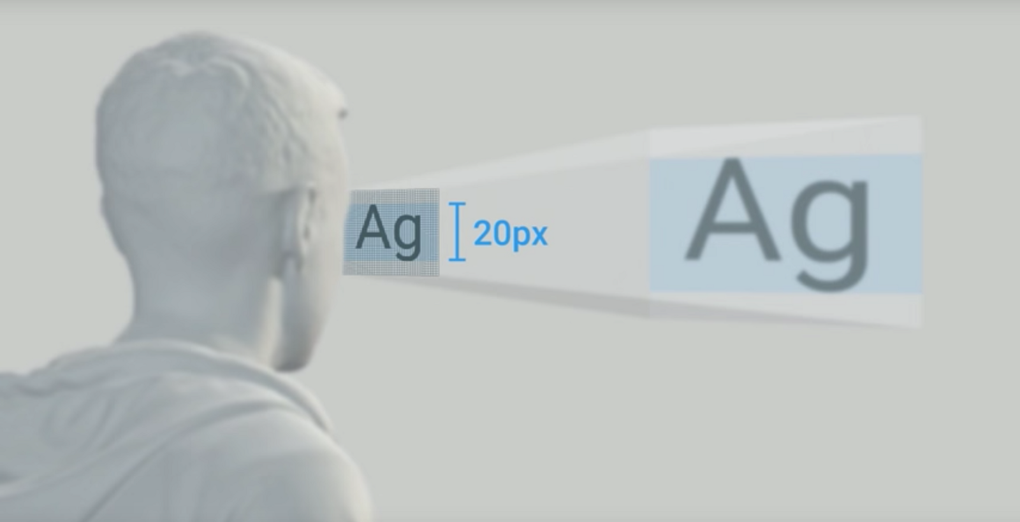
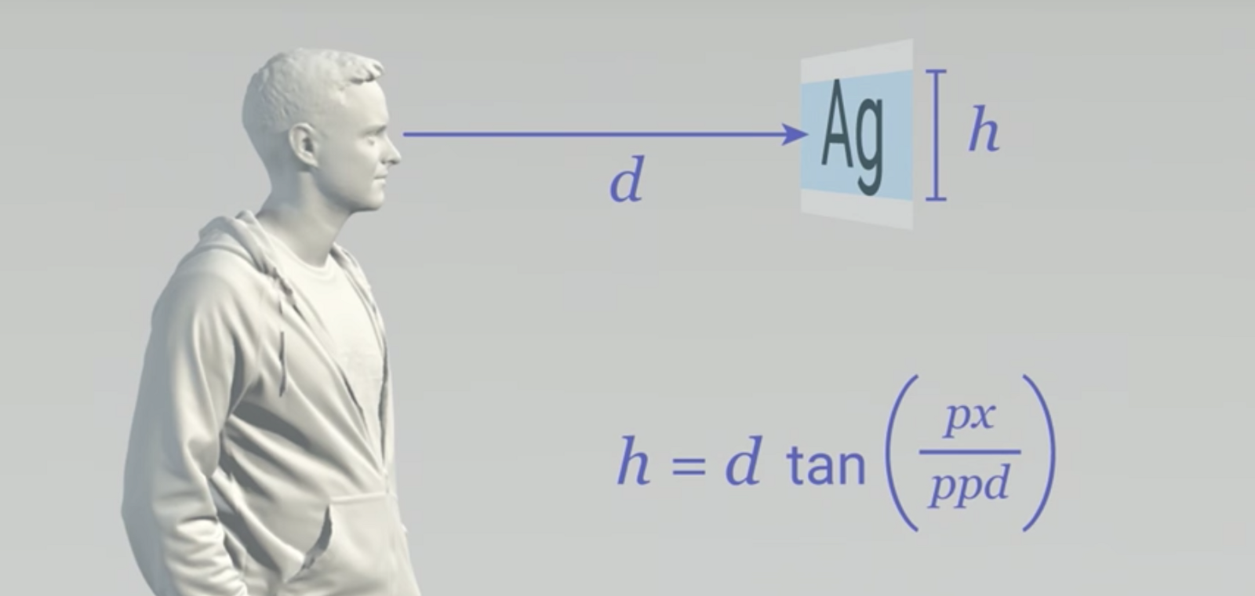
VR Design Specifics: UI: Text in VR Patrick O'Luanaigh (nDreams), Mike Alger, (Google)
User presence as an issue related to informing the player
Textual interfaces are an intrusion
Text will never completely go away
Put it only where it’s really needed
Resolution is a major constraint
Leads to aliasing with hard edges
Anti-aliasing helps but impacts performance
Avoid hard edges and thin lines
Text Resolution is impacted
Larger is better
Avoid showing text on white and translucent backgrounds.
Current HMDs are about 13 PPD (pixels per degree)
Text should be ~1.5° degrees tall
Or roughly 20px tall on most current displays
It should be >1.3 meters from the user
Alger
Alger

Slide 21
VR Design Specifics: UI, where does it belong Patrick O'Luanaigh (nDreams)
Minimal is best
Diegetic methods work best for VR
User presence as an issue related to informing the player
Textual interfaces are an intrusion
Text will never completely go away
Put it only where it’s really needed
If you need interface in the Content Area
Consider the Peripheral Zone
Better would be an on-arm or on controller interface
Gaze interface is interested

Slide 22
VR Design Specifics: UI, where does it belong Patrick O'Luanaigh (nDreams)
Minimal is best
Diegetic methods work best for VR
If you need interface in the Content Area
Consider the Peripheral Zone
Better would be an on-arm or on controller interface
Gaze based interface is interested

Slide 23
VR Design Specifics: UI, examples: UI in the content zone (Mike Alger)

Slide 24
VR Design Specifics: Interesting UI examples and widgets
Cosmic Trip: Menu Location
https://gfycat.com/bruisedglisteningblackbear
Disney VR Interface
https://medium.com/startup-grind/4-things-i-learned-designing-user-interfaces-for-vr-cc08cac9e7ec
We can track the head position
Ray cast and provide feedback as to cursor position
Remember user gaze often returns to the center
Move follow on menu choices off center
Feedback, for everything (hover, choose, chosen)
Cursor flash
Color change
Menu item color change (selected)

Slide 25
VR Design Specifics: UI Examples
UI in the periphery of the content zone (Dino Frontier) https://www.forrestthewoods.com/blog/the_vr_interface_of_dino_frontier/
Collection of interesting VR UI and UX elements
http://www.xr.design/tags/ui

Slide 26
VR Design Specifics
Movement Methods:
Generally movement shouldn’t be at the speed humans normally walk
Faster or slower is better
No acceleration
Don’t turn
Teleportation
Avoid changing orientation
Avoid acceleration while teleporting
Use frames of reference to anchor the destination (appropriate scale changes to objects)
Tunneling
Masking/removing the peripheral elements can help
https://www.youtube.com/watch?time_continue=31&v=9fgkpM6211w

Slide 27
VR Design Specifics: Teleportation movement
Collection of movement methods
Dash
Blindered
Teleportation
Gaze
Directed
Restricted Directed
Turning methods
Drag
Snap
http://www.xr.design/tags/ui

Slide 28
Getting their Attention - Audio
Audio is hard but is key to a successful VR experience
The auditory systems are very sensitive and update faster than the visual systems
Audio from outside the experience will disconnect the user from your experience
Audio done right will draw the user in, affirming the experience
It can set mood
Supply the implication of content presence without the content (bird sounds)
Needs to provide the key details of the world and be localized
Techniques for successful VR audio
Audio matching content in the near, mid-range and far range zones
Ducking (lowing non-important audio)
Listening Angle (things outside your FOV are attenuated)
https://www.google.com/search?q=Back+to+dinosaur+Island+VR+demo&rlz=1C1CHBF_enUS802US802&source=lnms&tbm=isch&sa=X&ved=0ahUKEwjS4_Kr5q_gAhVL7YMKHd9RBLoQ_AUIECgD&biw=973&bih=935#imgrc=btjTyrFfrWCgLM:

Slide 29
Latest Updates regarding VR Tech
Qualcomm is leading the way with wireless VR/AR
Shares the processing with a PC - PC sends graphics and game content, VR set sends 6DOF room tracking back
Vive Focus Plus
1440x1600 pixels per eye, tethered
Price, $799
Oculus
Rift S, $399
1280x1440 pixels per eye, tethered
Internal tracking for location and hand tracking
Lower refresh rate (80 vs 90hz) but has a lower pixel persistence allowing for less smearing as you turn
Quest, $399
1440x1600 untethered
64g storage, 72hz refresh, 95deg FOV

Slide 30
Latest Updates regarding VR Tech
Valve’s Index:
Launch 6/15
Tethered (recommends a fairly high end video card)
Price not announced though it will be competitive for the base unit (comes without controllers)
HP Reverb
Windows Mixed reality (no external tracking required)
Twice the pixels of the Odyssey+ and 3.5 times the pixels as the Rift
2160x2160 pixels per eye, tethered
Slightly larger field of view
Price between $600 and $650

Slide 31
VR Design Examples/critique and discussion
No Man’s Sky VR
https://www.nomanssky.com/2019/03/no-mans-sky-beyond-vr/
Boneworks
https://uploadvr.com/boneworks-feels-like-the-first-next-generation-vr-game/

